Slide 1
KiCad PCB 设计讲座
以NFC名片设计为例
清华大学未来通信兴趣团队
张庭梁

Slide 2
Part 1 PCB及电子电路相关知识补充

Slide 3
Part 2 设计
Copyright © ZHANG TINGLIANG 2019

Slide 4
ISO 7810
ISO 7810，是身份证、银行卡等尺寸的国际标准，分为ID-1、ID-2、ID-3及ID-000四种。现时采纳的版本为2003年版。
ID-1的规定尺寸为85.60×53.98毫米（3.370×2.125英寸），常用于身份证、银行卡（如提款卡、信用卡）、驾照、个人名片，以及商店发出的忠实顾客卡等。
其长宽比与黄金分割（1.618:1）接近。
ISO 7813规范ID-1塑胶银行卡的附加特性，包括0.76毫米厚度，及3.18毫米半径的圆角。
样式 | 尺寸 | 用途
ID-1 | 85.60 × 53.98 mm | 绝大多数银行卡及身份证
ID-2 | 105 × 74 mm | 法国身份证等；签证
ID-3 | 125 × 88 mm | 护照
ID-000 | 25 × 15 mm | SIM卡

Slide 5
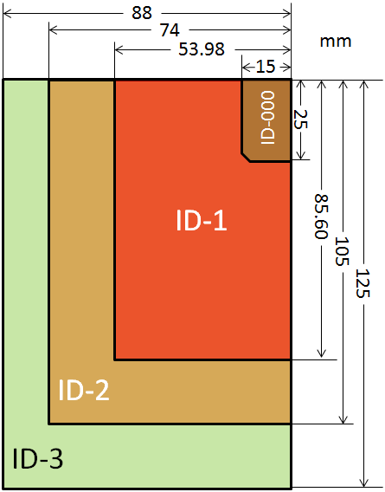
设计为
85.60×53.98毫米
3.18毫米半径的圆角
0.76毫米厚度（做0.8mmPCB板）

Slide 6
丝印和Top图案设计和导入
使用Ai设计表面丝印BMP

Slide 7
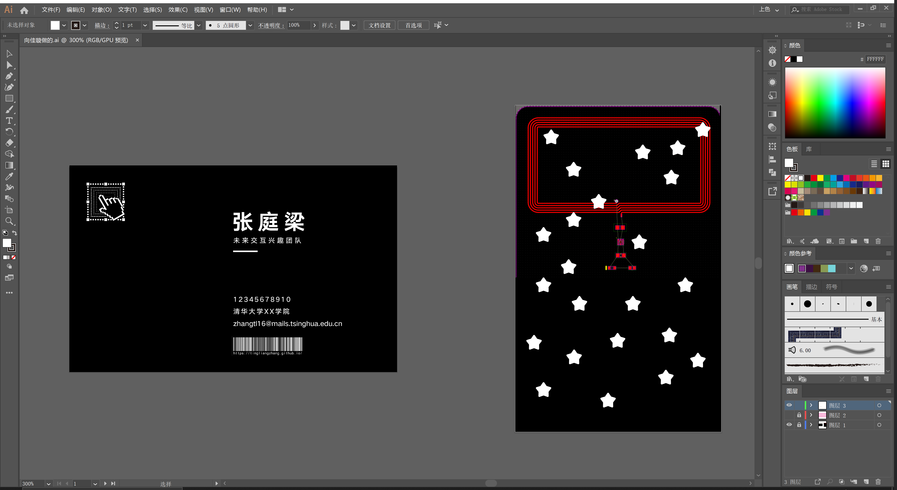

Slide 8
Referance
https://en.wikipedia.org/wiki/ISO/IEC_7810

Slide 9
NFC原理和天线设计
https://www.themobileknowledge.com/wp-content/uploads/2018/07/02-Webinar-slies-Antenna-design-for-NTAG-I2C-plus.pdf

Slide 10
下面是补充知识，不想听电路的同学可以先睡一会

Slide 11


How NTAG I²C plus works
2

Slide 12
NFC focus products for each application need
Readers/connected tags: for embedded electronics
Specialist
One chip system, programmable NFC controller with DPC
PN7462 family
High-perf full NFC with DPC
PN5180
Features and price
All round
Single-chip MCU with integrated NFC tag
LPC8N04
High-perf multi-protocol reader
CLRC663 plus
Plug&Play NFC for Linux, Android,
WinIoT
PN7150
Entry level
Proximity&vicinity readers
MFRC630
(ISO14443A – Reader for NTAG® and MIFARE® product families)
SLRC610
(ISO15693 / ISO18000-3M3 - Reader for ICODE® family)
NTAG I²C plus
Connected tag solutions
NFC tags with non-volatile memory and host connection or integrated MCU
NFC Frontend solutions
NFC reader with NFC Reader SW Library
NFC controller solutions
NFC reader with integrated
32-bit Cortex MCU and either integrated
firmware or freely programmable memory
3

Slide 13
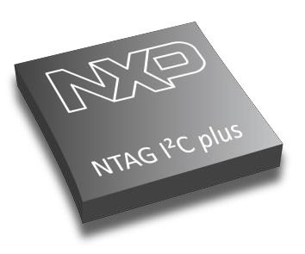

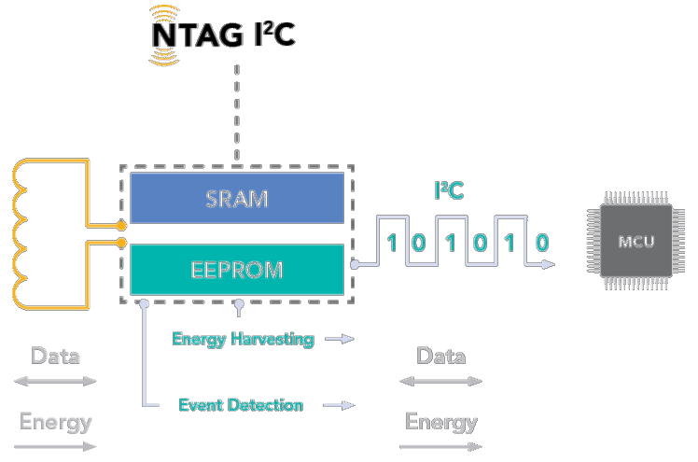


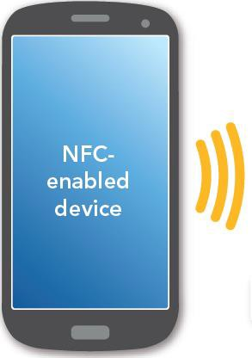








How NTAG I²C plus works
The NTAG I²C plus needs to be connected to the antenna coil with L_{A} and L_{B} pads
The NTAG I²C plus connects to the microcontroller via the I²C serial bus interface
Field Detection
Energy harvesting
SRAM memory
SRAM mirroring
Pass-through mode
Memory access management
NFC-enabled mobile device connects to the MCU via the NFC interface, using the I²C as the communication conduit
Originality signature
4

Slide 14

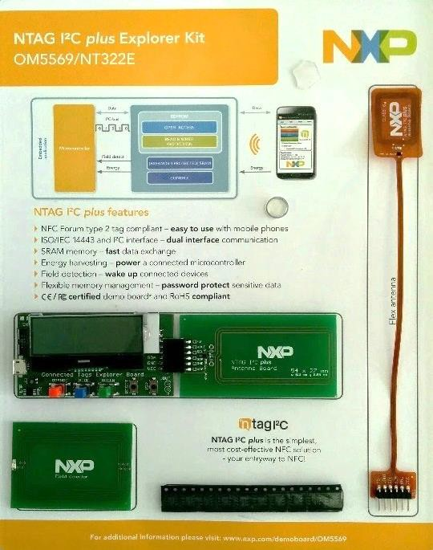
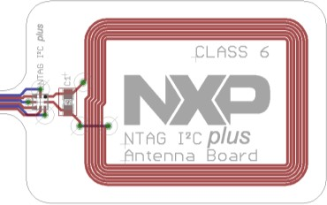
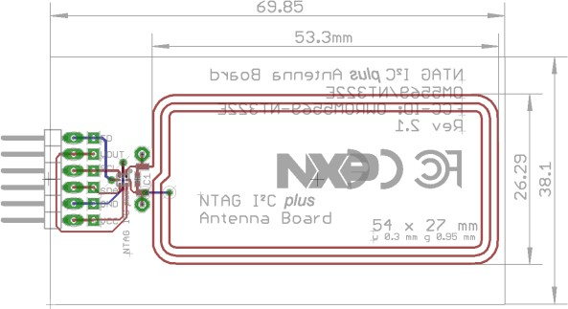
NTAG I²C plus support package: Antenna design files
SW3641 - NTAG I²C plus
flex antenna Class 6
If you do not have constrains about the antenna size or shape:
NXP offers the designs files for the Class 4 and Class 6 antennas included as part of the NTAG I²C plus Explorer kit (OM5569)
SW3639 - NTAG I²C plus Class 4
AN11276 – NTAG Antenna design
If you need your custom antenna for your design:
guide
NXP offers an Excel-based coil calculation tool to estimate the inductance of rectangular and round antennas *
* More details in slide 18
5

Slide 15
Basic antenna theory for NTAG I²C plus tags
6

Slide 16
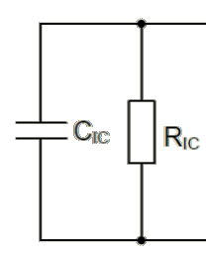
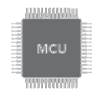
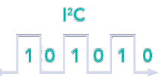
NTAG I²C plus electrical input capacitance
NTAG I²C plus IC
NTAG I²C plus IC connections
La, Lb = NTAG I²C plus pads to be connected to the antenna
FD
Vout
SCL
SDA
Gnd VCC
La
Antenna coil
NTAG I²C plus IC input capacitance
It is the most important factor for the
antenna design.
The form factor and the parameters of the antenna are affected by the input capacitance
to MCU
Lb
NTAG I²C plus equivalent circuit
C_{IC}= NTAG I²C plus input capacitance (50pF)
7

Slide 17
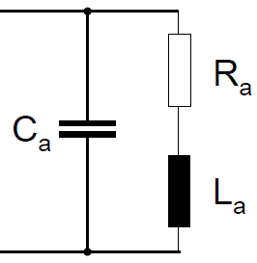
Antenna coil electrical equivalent circuit
NTAG I²C plus IC
Antenna coil
Each antenna is a resonant circuit with a specific input impedance.
FD
Vout SCL
SDA
Gnd VCC
La
This input impedance is complex and consists of an inductance, capacitance as well as some losses represented by a resistance.
Antenna coil
A
n t e
n
na
c o
i l
to MCU
Lb
The actual values depend on
Antenna material
Thickness of conductor
Distance between the windings
Number of turns
Shielding layer
Environment
NTAG I²C plus equivalent circuit
Antenna coil equivalent circuit
C_{IC}= NTAG I²C plus input capacitance (50pF)
8

Slide 18
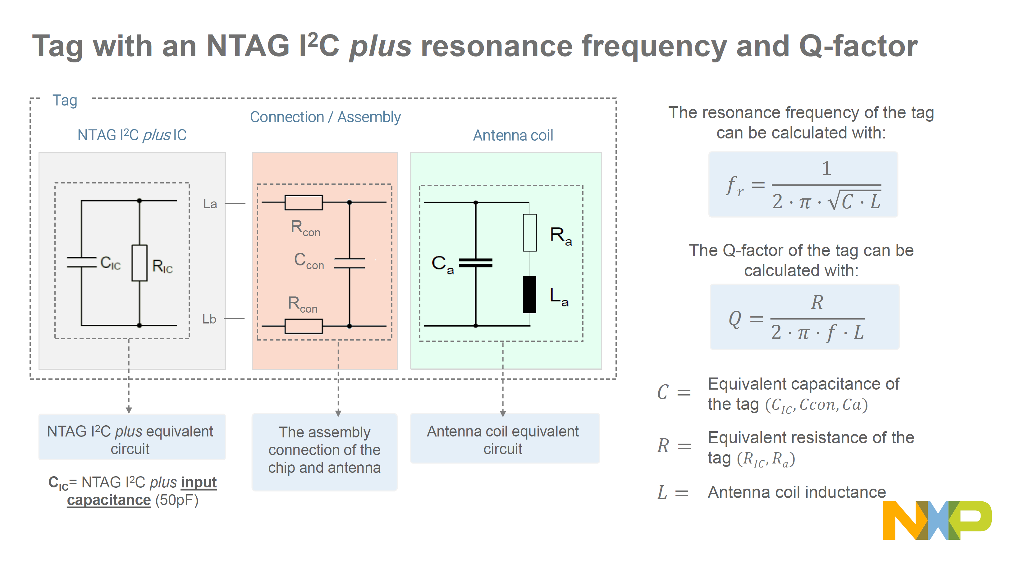

Slide 19
Antenna design procedure for NTAG I²C plus tags
11

Slide 20
Antenna design procedure for NTAG I²C plus tags
1. Design the antenna coil
Determine the size and the specs of the antenna
(number of turns, track width, spacing, etc.)
NTAG I²C plus + antenna coil= resonance circuit
NTAG I²C plus |  | Connection / Assembly |  | Resonant capacitor
2. Measure antenna coil
Characterize R,L,C antenna coil parameters
3. Calculate the resonant capacitor value Determine the value of resonant capacitor to set the tag to the target resonant frequency
Antenna coil
4. Assemble & measure resonant frequency Measure the resonant frequency and adjust the capacitor value if needed
The precision of the antenna equivalent inductance computation, the length of the connection between the chip and its antenna, and the environment (metal surface, ferromagnetic material) impact the tuning frequency.
12

Slide 21
Design the antenna coil
13

Slide 22
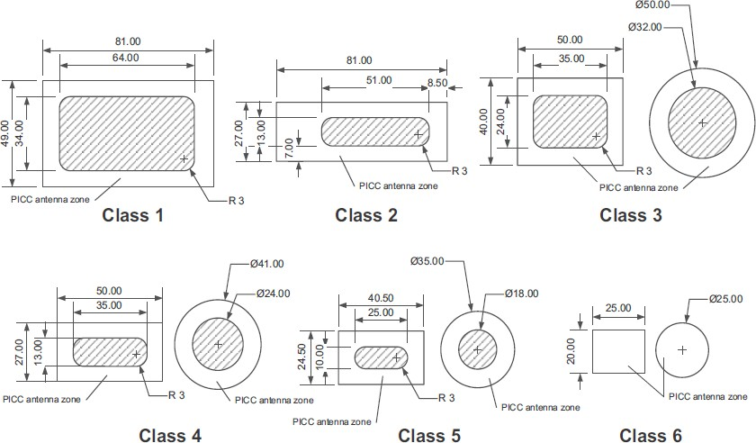
Antenna class based on ISO/IEC14443
ISO/IEC 14443-1 defines 6 antenna classes, also referred to in ISO/IEC 15693.
The use of ISO/IEC14443 antenna class is optional but it has been established that the use of a prescribed class may enhance interoperability
14

Slide 23
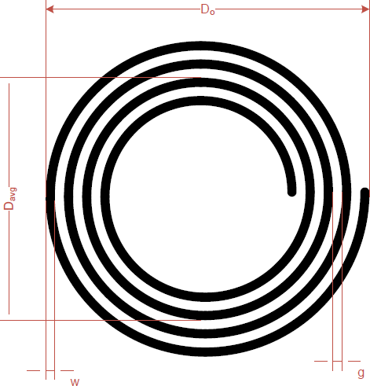
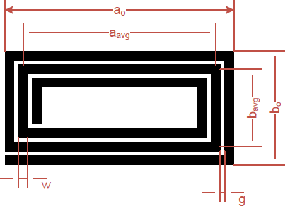
Antenna parameters for rectangular and round antennas
Antenna geometry
Material properties
ρ → Electric conductivity ε_{r} → Permittivity of card material
D₀ → | Definition of the antenna diameter (mm) | •
w → g → t → N → | Track width in mm, Gap between tracks (mm), Track thickness Number of turns | •
Antenna geometry
a₀ → Definition of the overall length (mm)
b₀ → Definition of the overall width (mm)
w → Track width in mm
g → Gap between tracks (mm)
t → Track thickness
N → Number of turns
Inductance of an antenna depends on the antenna dimensions and material properties
15

Slide 24
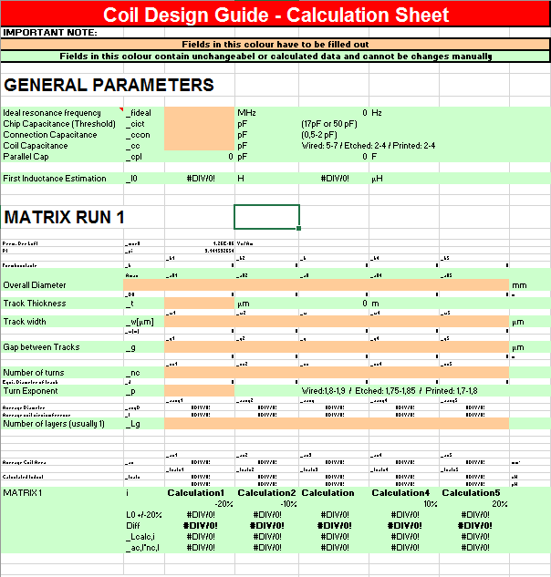
Coil design calculation sheet
This coil design guide calculation sheet uses antenna dimensions and estimates the antenna equivalent inductance.
The following steps are a reliable method to design and fine tune a custom antenna coil:
Estimation of the electrical parameters
Definition of the target inductance
Definition of the dimensions
Definition of the matrix run
Production of samples
Selection of the best coil parameters
Definition of second matrix run (if needed)
Excel calculation sheet tool included in https://www.nxp.com/docs/en/application-note/AN11276.zip
16

Slide 25
Measure the antenna coil parameters
17

Slide 26
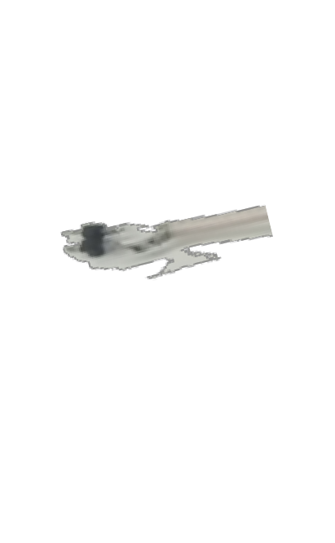
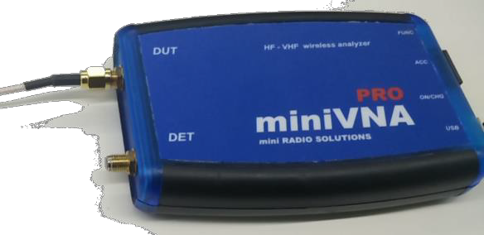


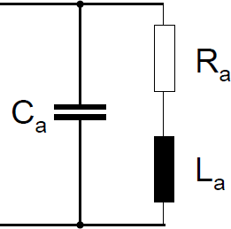
Measuring the antenna coil parameters
The antenna loop has to be connected to a network analyzer to measure the antenna equivalent circuit (R_{a}, L_{a}, C_{a})
Before each measurement, the network analyzer must
be calibrated (open, short and load compensation).
Settings: S11
Chart: Smith Z
Start frequency: 1 MHz
Stop frequency: Above self-resonant frequency
NTAG I²C plus
Antenna coil
High-end or Low-end network analyzer (e.g., miniVNA PRO)
Note: The antenna has to be at the final mounting position to consider all parasitic effects like metal influence on quality factor, inductance and additional capacitance
Fig. Antenna series equivalent circuit (C_{a}, L_{a}, R_{a})
18

Slide 27
Calculate the resonant capacitor value
19

Slide 28


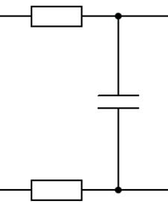
Calculating the parallel resonance capacitor
Antenna coil
We measure the current system resonance frequency (𝑓_{𝑟 − 𝑐𝑢𝑟𝑟𝑒𝑛𝑡}) after connecting the NTAG I²C plus to the antenna coil.
If it is not 𝑓_{𝑟 − 𝑐𝑢𝑟𝑟𝑒𝑛𝑡}~ 13.56𝑀𝐻𝑧 , we calculate the system capacitance at the current resonance frequency with this formula:
1
𝐶
=
La
^{R}con ^{C}con
^{R}con
𝑓𝑟 ₋ 𝑐𝑢𝑟𝑟𝑒𝑛𝑡
2 · 𝜋 · 𝑓
² · 𝐿
𝑟𝑒𝑠
A
n t e
n
na
c o
i l
Note: The inductance of the system is basically the inductance of the antenna (L=La).
Lb
NTAG I²C plus IC
Connection
Antenna coil
20

Slide 29

Calculating the parallel resonance capacitor (II)
Resonance capacitor
Antenna coil
If we fix the desired system resonance frequency (𝑓_{𝑟 − 𝑡𝑎𝑟𝑔𝑒𝑡}), the capacitance required so that the system resonates at that target frequency can be calculated with this formula:
1
𝐶 =
𝑡𝑎𝑟𝑔𝑒𝑡
2 · 𝜋 · 𝑓_{𝑟}
² · 𝐿
𝑡𝑎𝑟𝑔𝑒𝑡
−
We can calculate the extra capacitance that needs to be soldered in parallel (C_{Res}) by:
Tag
La
^{C}Res
^{R}con ^{C}con
^{R}con
^{𝐶}𝑅𝑒𝑠 ^{= 𝐶}𝑡𝑎𝑟𝑔𝑒𝑡 ^{− 𝐶}𝑓𝑟 ₋ 𝑐𝑢𝑟𝑟𝑒𝑛𝑡
A
n t e
n
na
c o
i l
Note: For single tag operation, a tuning slightly above 13.56 MHz would lead to maximum read-/write distance. Due to manufacturing tolerances, a nominal frequency of 14.5 MHz for single tag operation is recommended.
Lb
NTAG I²C plus IC
Resonance capacitor
Connection
Antenna coil
21

Slide 30
Assemble & measure resonant frequency
22

Slide 31
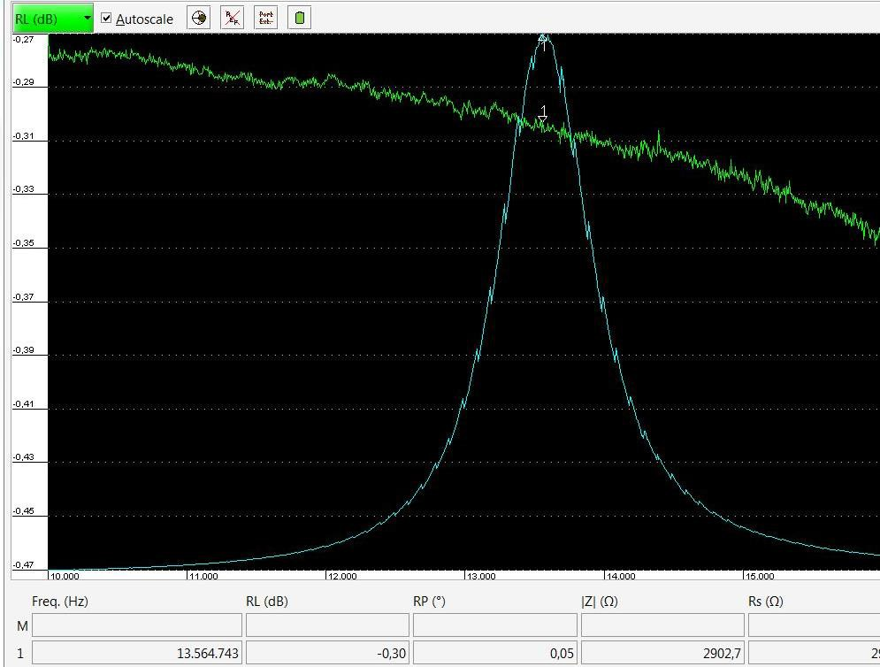

Assembling and measuring the tag resonant frequency
Assemble the calculated 𝑪_{𝒓𝒆𝒔} capacitor in your design.
Then, measure the resonant frequency (𝒇_{𝒓𝒆𝒔}) at which the resistance impedance (Z) is maximum
If the resonant frequency is not the target resonant frequency, fine tune the capacitor value. If the frequency is high, increase the capacitor value; if low, decrease it.
Resonance Antenna coil
capacitor
Fig. Example of a tag adjusted to 𝒇_{𝒓𝒆𝒔} = 13.564 MHz
23

Slide 32
Recap and closure
29

Slide 33
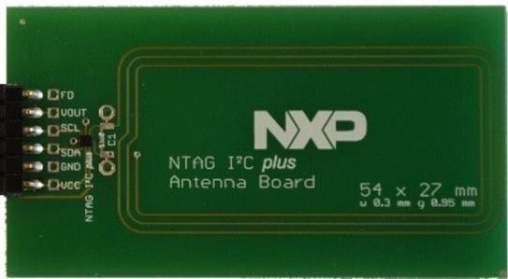

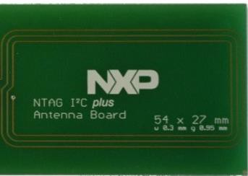
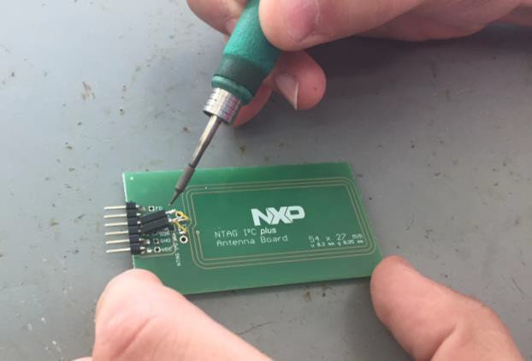

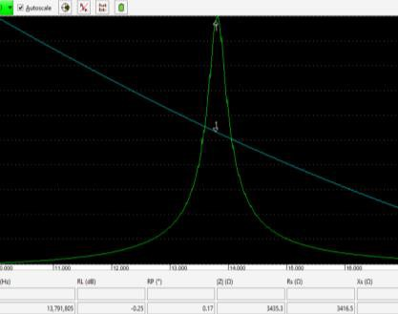
Recap of the antenna tuning steps followed
Design the antenna coil
Determine the size and the specs of the antenna
(number of turns, track width, spacing, etc.)
Measure antenna coil
Characterize R,L,C antenna coil parameters
Calculate the resonant capacitor value Determine the value of resonant capacitor to set the tag to the target resonant frequency
Assemble & measure resonant frequency Measure the resonant frequency and adjust the capacitor value if needed
We selected 54x27mm PCB antenna board included in OM5569-NT322E kit
We separate the NTAG I²C plus from the PCB board to characterize the antenna parameters
We solder an extra capacitance of 100pF
This is the adjusted antenna tuning at
𝒇_{𝒓𝒆𝒔} =13.8MHz
30

Slide 34

Further information
NTAG I²C plus:
http://www.nxp.com/products/:NT3H2111_2211
NTAG antenna design guide: https://www.nxp.com/docs/en/application- note/AN11276.zip
Get your technical NFC questions answered: https://community.nxp.com/community/identificati on-security/nfc
List of Approved Engineering Consultants (AEC) for NFC:
https://nxp.surl.ms/NFC_AEC
31

Slide 35
Altium Designer PCB Design
清华大学未来通信兴趣团队
张庭梁

Slide 36
Part 3 AD20使用
Copyright © ZHANG TINGLIANG 2020

Slide 37
Part 4 PCB交付制作和元件焊接
张庭梁

Slide 38
PCB代工厂
嘉立创
国外：https://jlcpcb.com/
国内：https://www.sz-jlc.com/
捷多邦
国外：https://www.pcbway.com/
国内：https://www.jdbpcb.com/

Slide 39
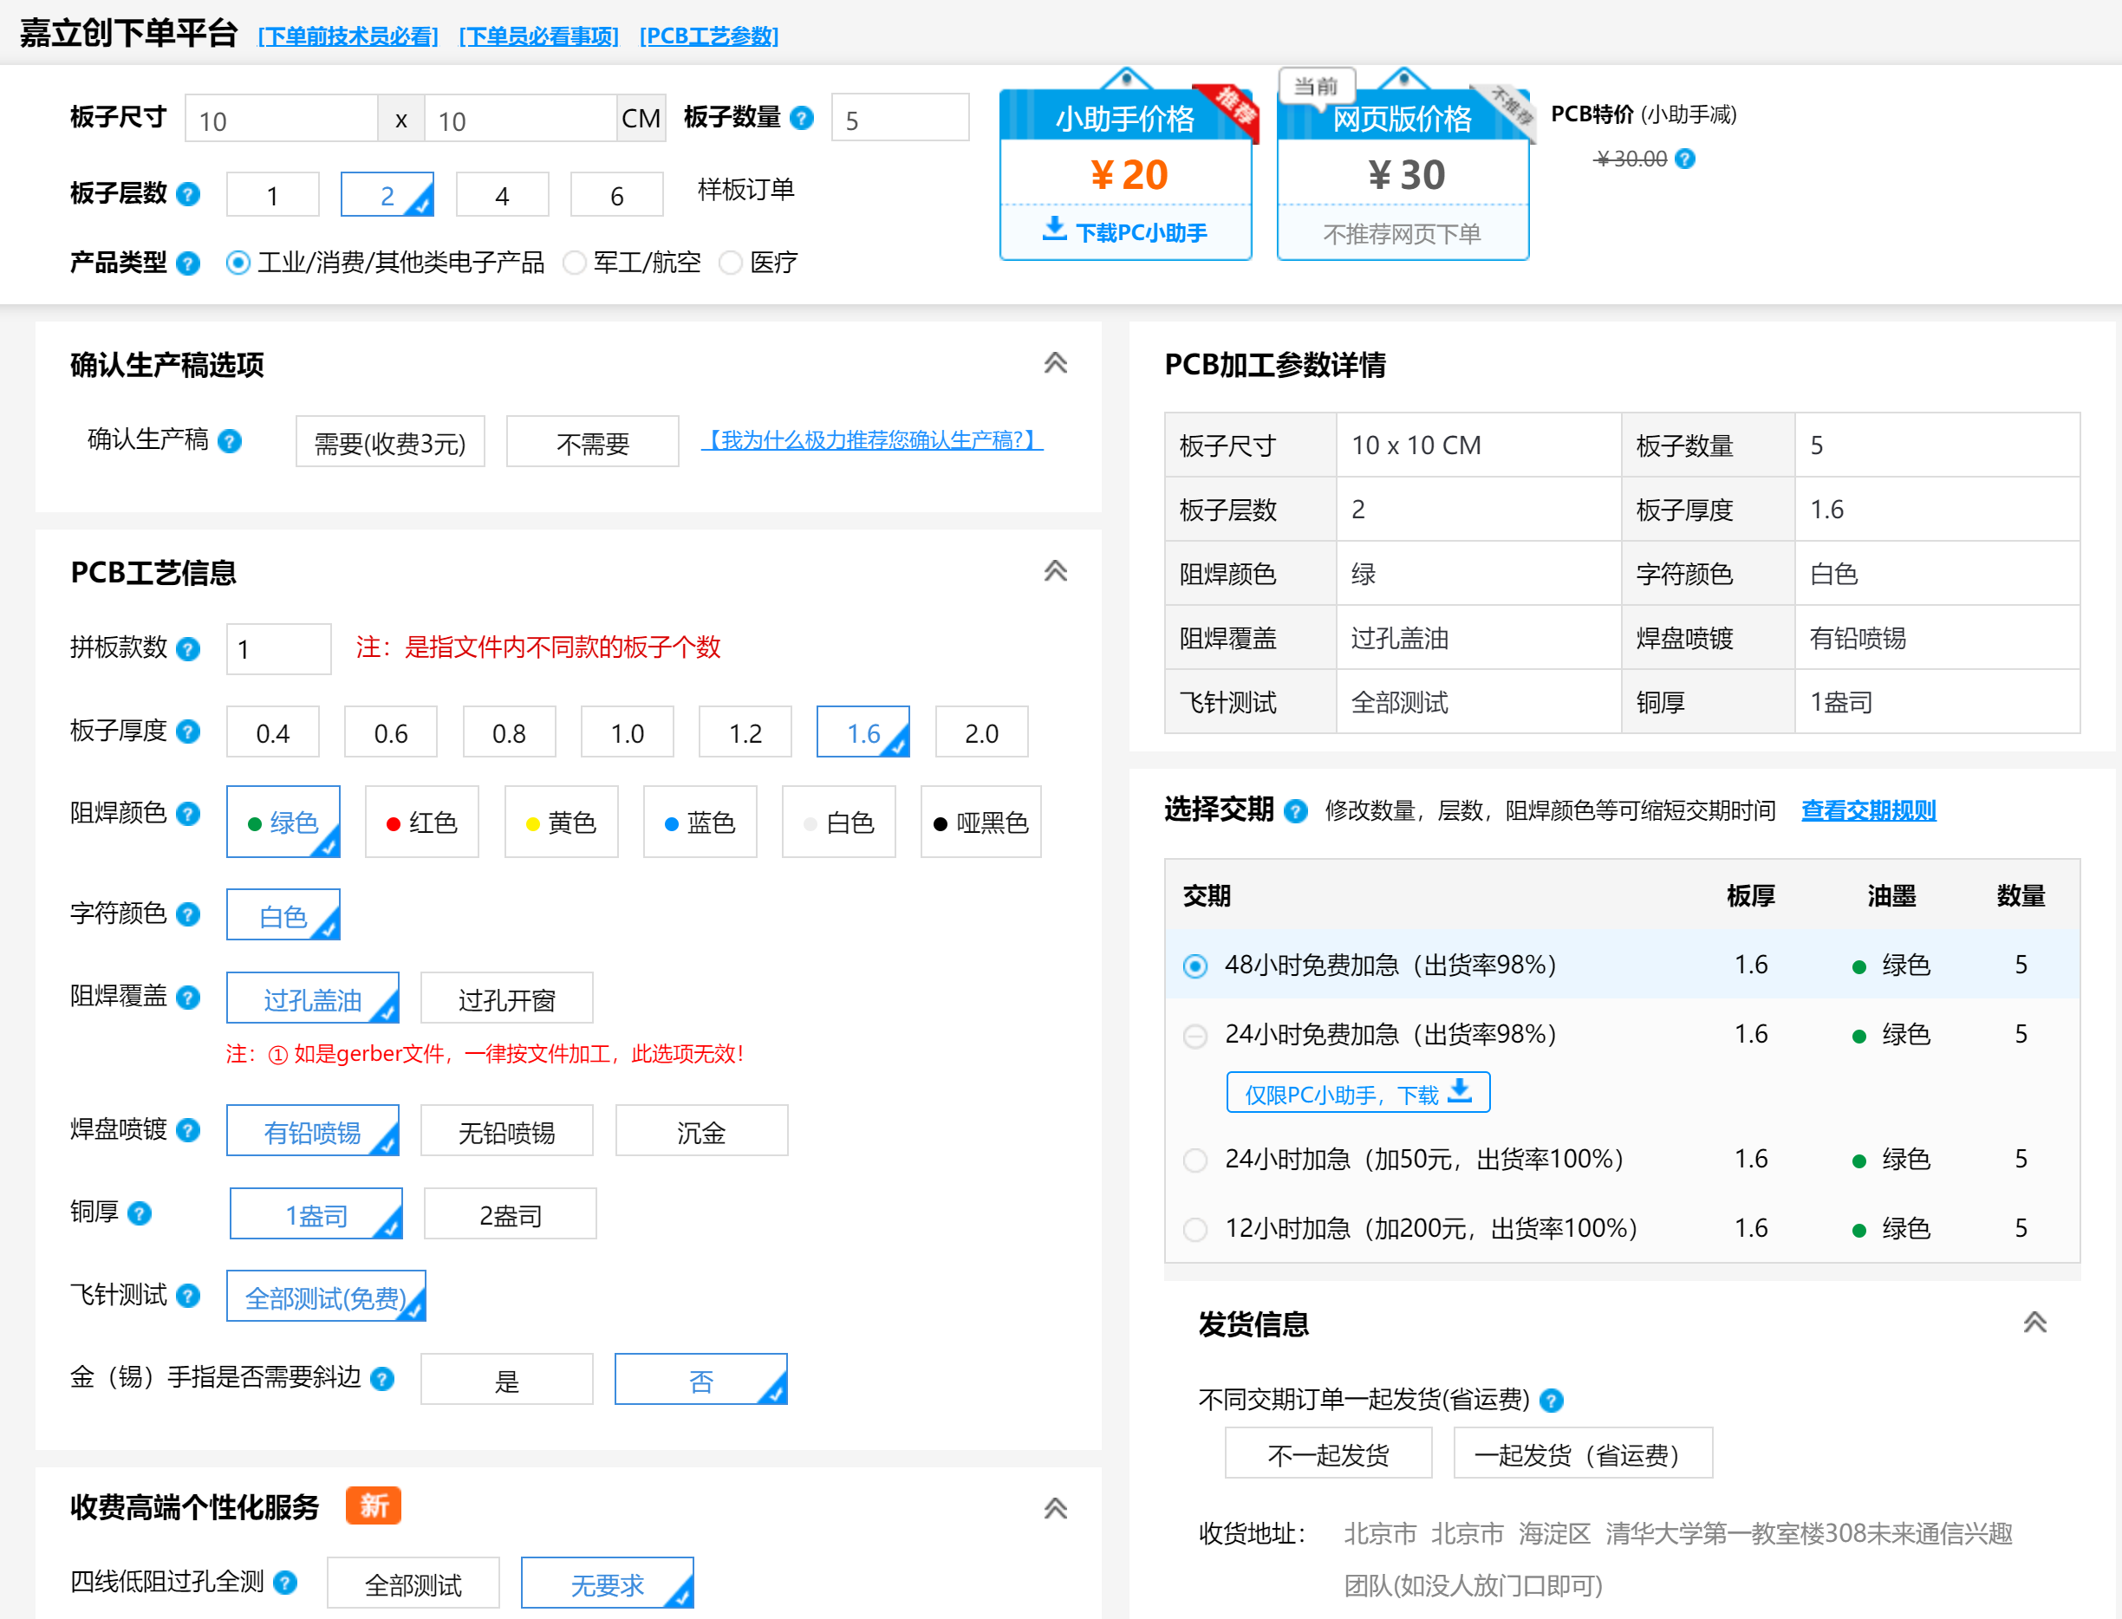

Slide 40
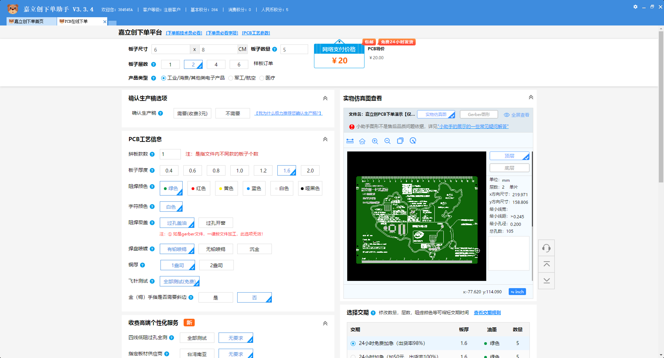

Slide 41
元件购买
立创商城
https://www.szlcsc.com/

Slide 42
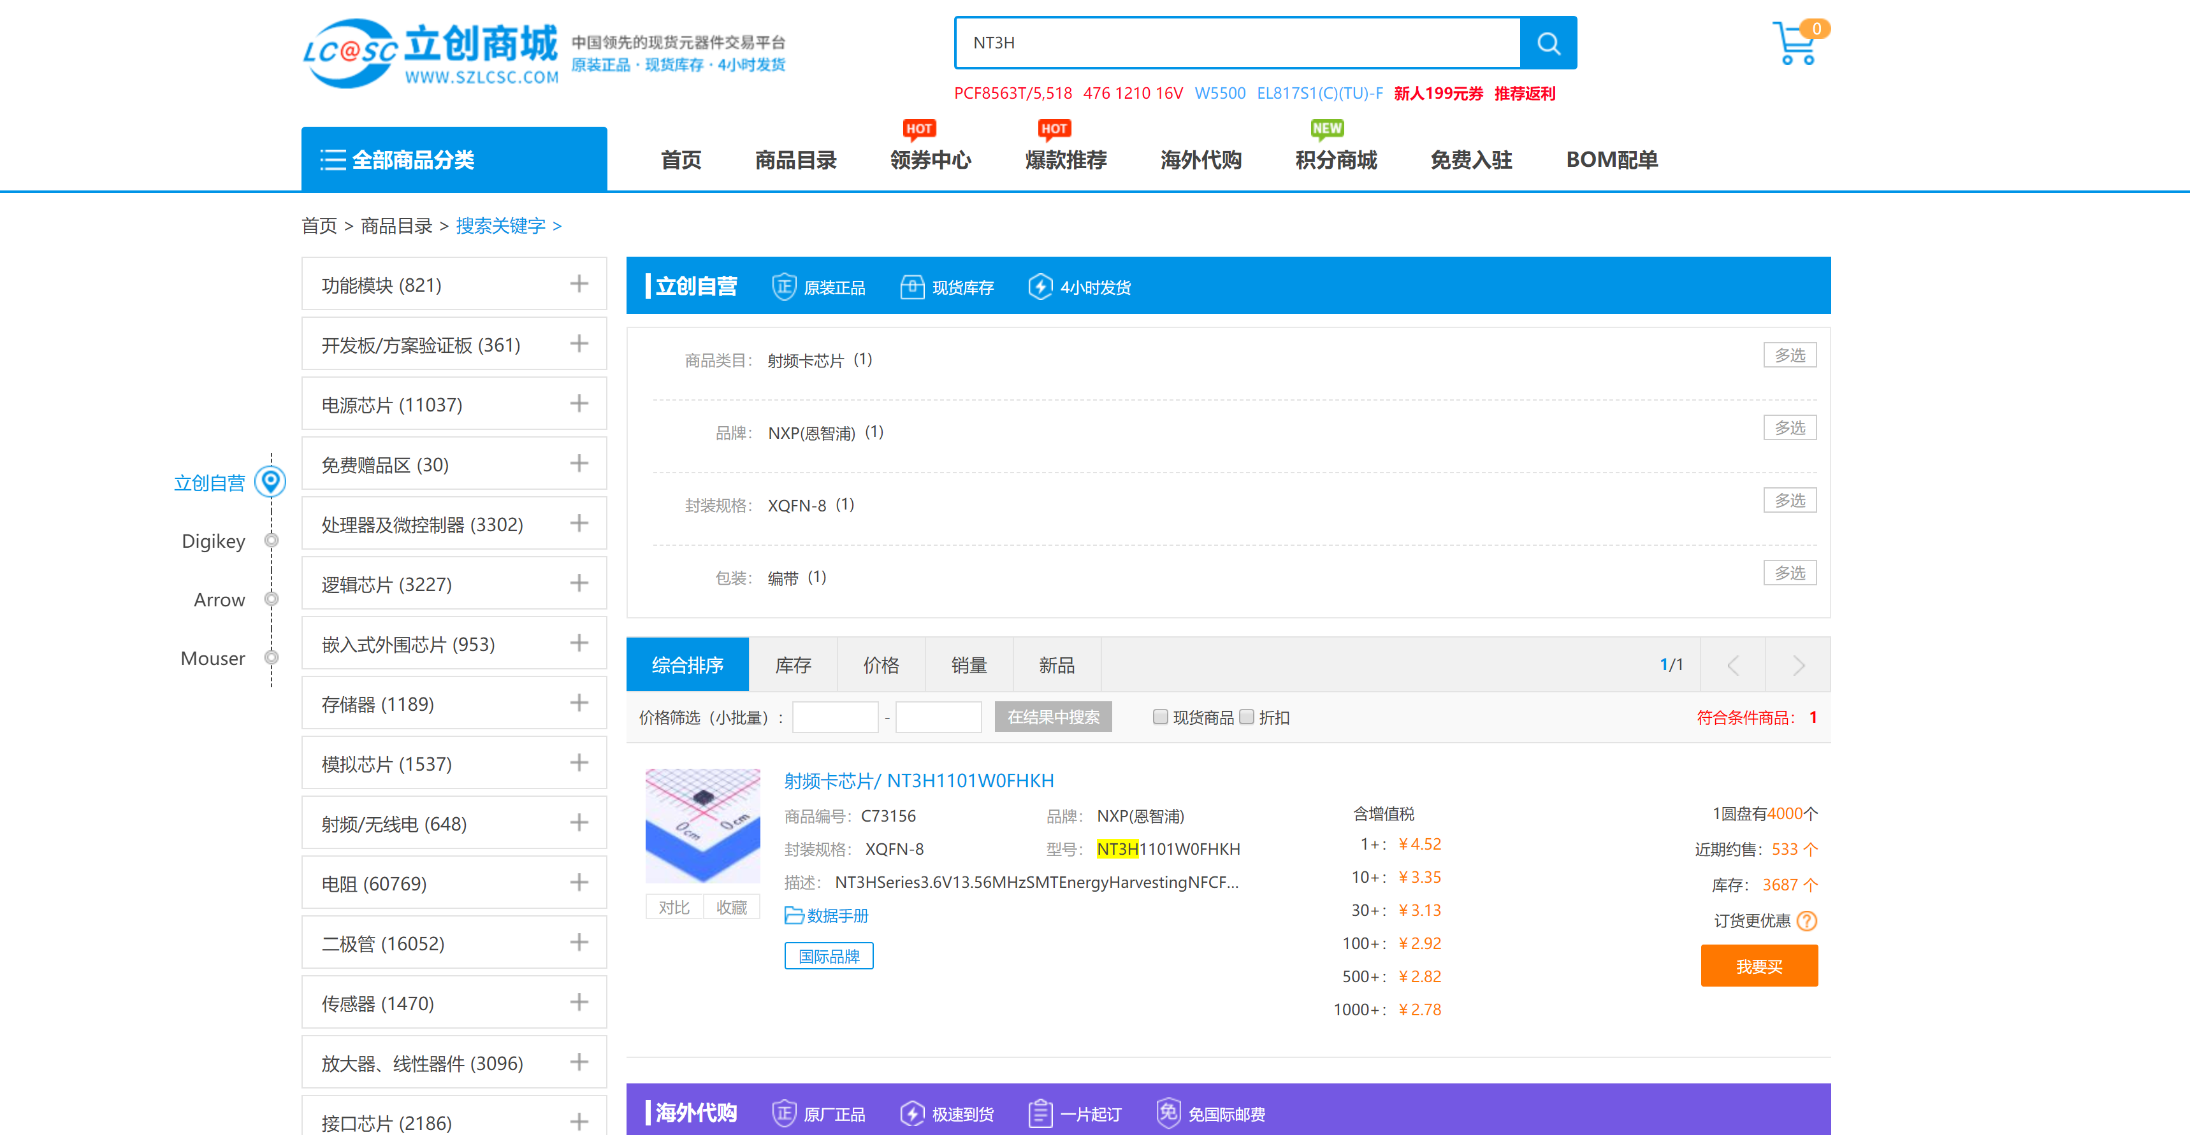

Slide 43
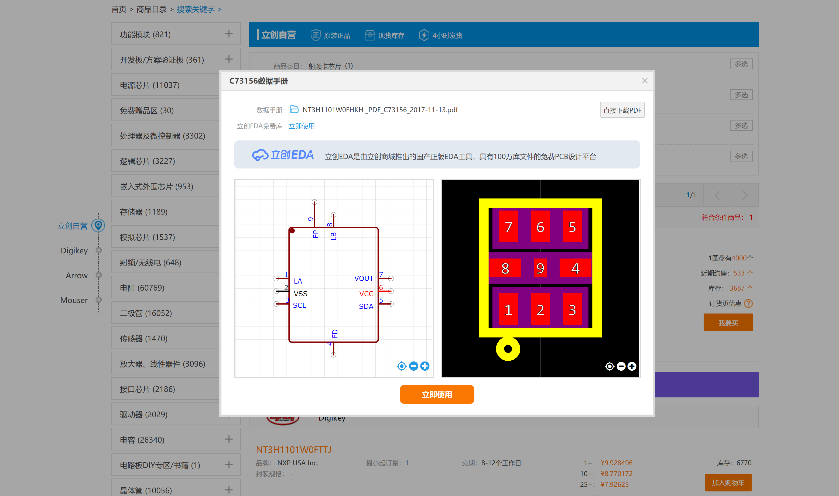

Slide 44
贴片焊接
锡膏+热风枪+精密镊子
电烙铁
SMD Soldering Microscope Footage
https://www.youtube.com/watch?v=tQHDSXDZYF4

Slide 45
QFN封装
SOP封装的芯片和引脚间距都较大的QFP，基本上直接用刀头加锡往外刮两下就完事，问题不大。这里重点讲下引脚密集的QFN封装的焊接。先固定芯片，步骤如下：
• 把芯片平置于 PCB 上，焊盘不用加锡，否则芯片放不平，极易虚焊
• 注意芯片一脚方向与PCB对应（一脚通常在小圆圈或正看丝印左下角位置）
• 对齐芯片四边引脚与焊盘，要兼顾四边是个非常虐心工作
• 烙铁加锡固定的一边的边缘几个引脚，查看四边对齐情况，没对准还有挽救机会——用烙铁重新调整芯片位置
• 烙铁加锡固定对边的几个引脚

Slide 46
这样一来芯片就被固定好了，接下来就开始焊了（很多元件都是“先固定，再焊接”的套路），焊的时候也需留个心眼：
1、选择没有焊锡固定的一边，开始焊接
2、用烙铁蘸助焊剂涂抹一边引脚与焊盘
3、从一边加锡，拼命加到形成锡球
4、用烙铁往另一边引流焊锡，被锡润湿过的引脚自然就焊上了
5、用烙铁头的粘性把多余的锡移除。
6、如法炮制剩下的三边
7、四边都焊好后检查引脚是否黏连、短路，必要时补焊。

Slide 47
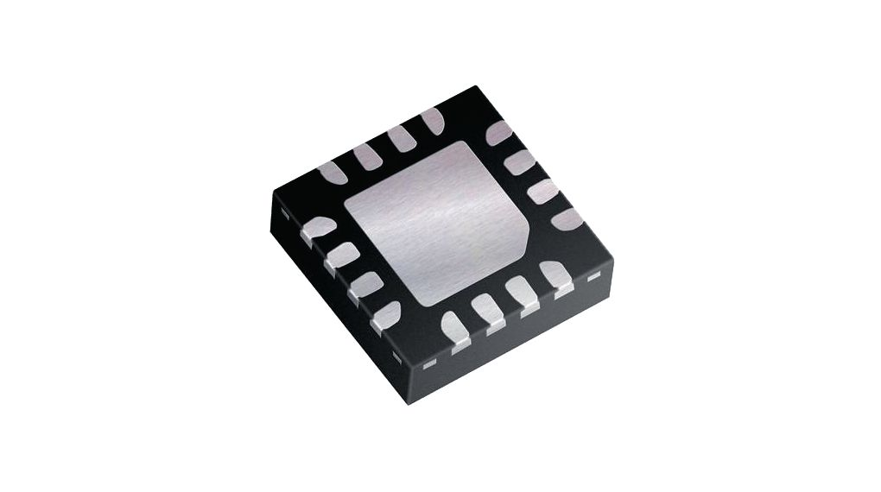
总之焊芯片只要记住两点： 1、焊的时候先多加锡，引脚连起来也无所谓，焊好后再慢慢分开。 2、多加助焊剂，助焊剂能让焊锡流动性更好，而不是像一坨粘粘的shi一样。油管上有个视频专教焊QFP芯片的：Professional SMT Soldering: Hand Soldering Techniques - Surface Mount。

Slide 48
电容电阻、二极管
电容电阻等二端元件是最常见的了，比较常用的焊法是：先给一边焊盘上锡，用镊子焊上一边固定，再焊另一边。这种方法最大的好处就是易于调整元件位置（因为有镊子辅助），所以焊好的元件看起来整齐美观。缺点也很明显——效率太低（也是因为要拿镊子）。尤其在面对有大量元件的PCB时，一个一个脚的焊似乎有点慢……

Slide 49
Ref
http://mcu.eetrend.com/blog/2017/100008018.html

Slide 50
Part 5 写入信息

Slide 51
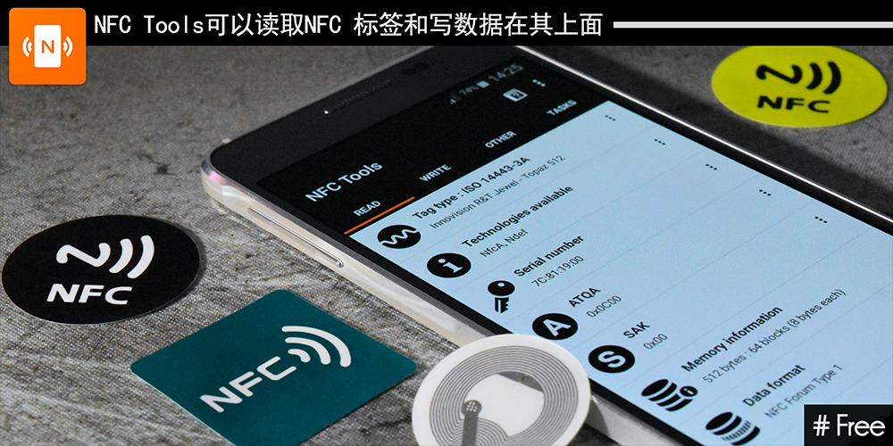
使用NFC App即可
NFC Tools/ NFC Tools Pro
https://play.google.com/store/apps/details?id=com.wakdev.wdnfc&hl=zh

Slide 52
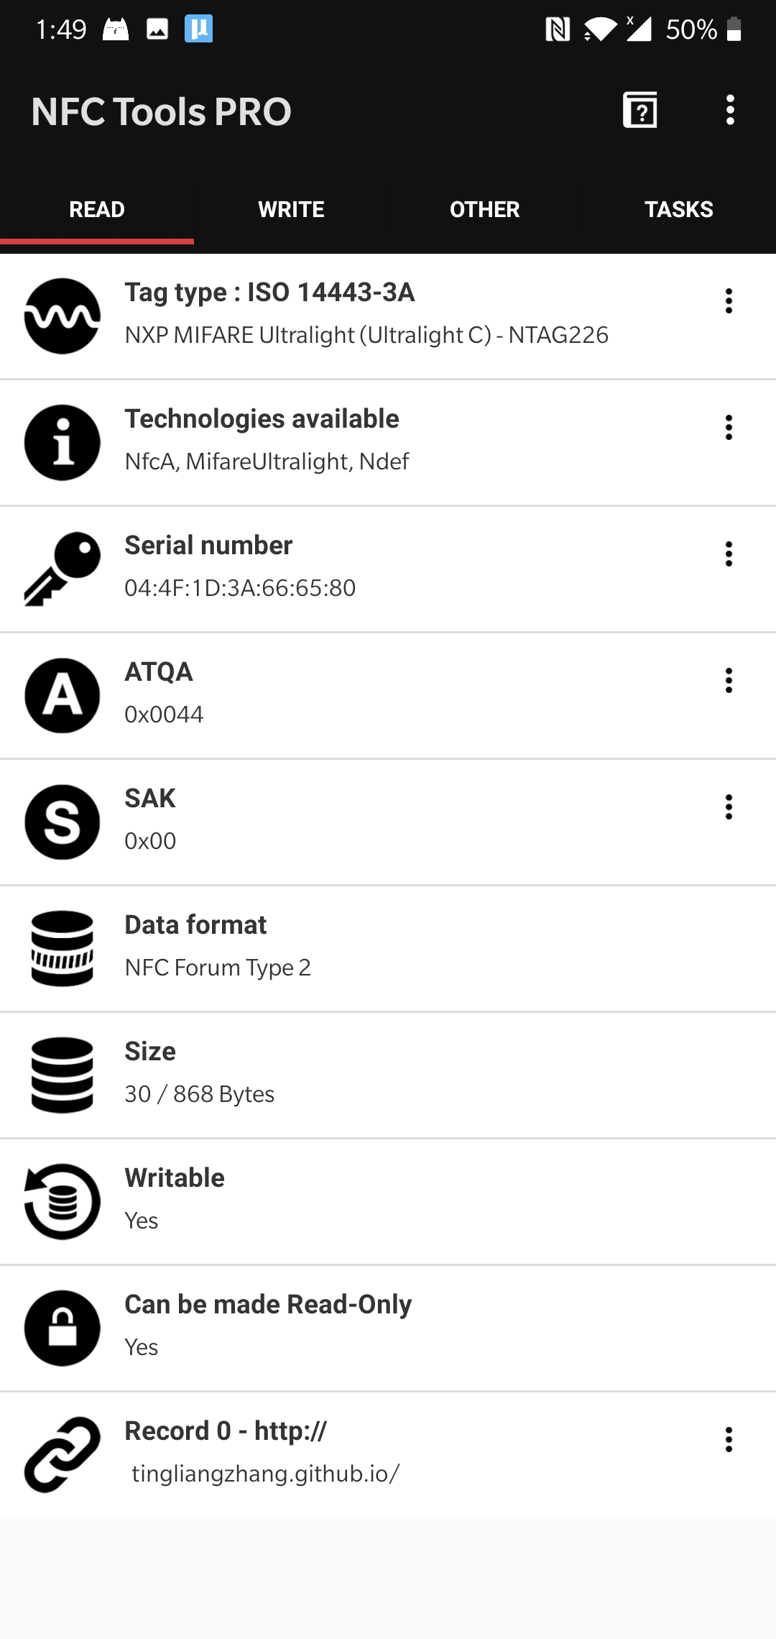
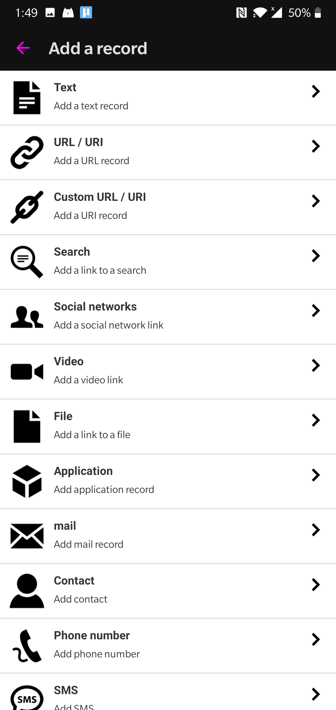
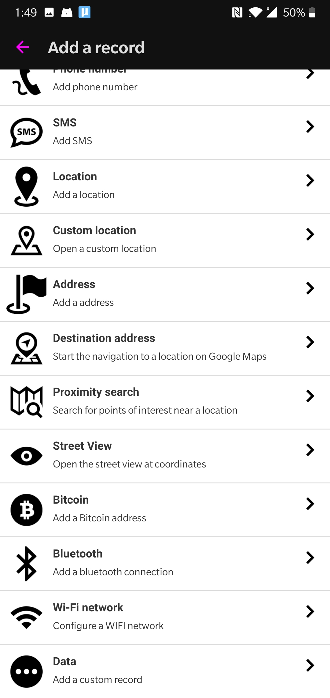

Slide 53

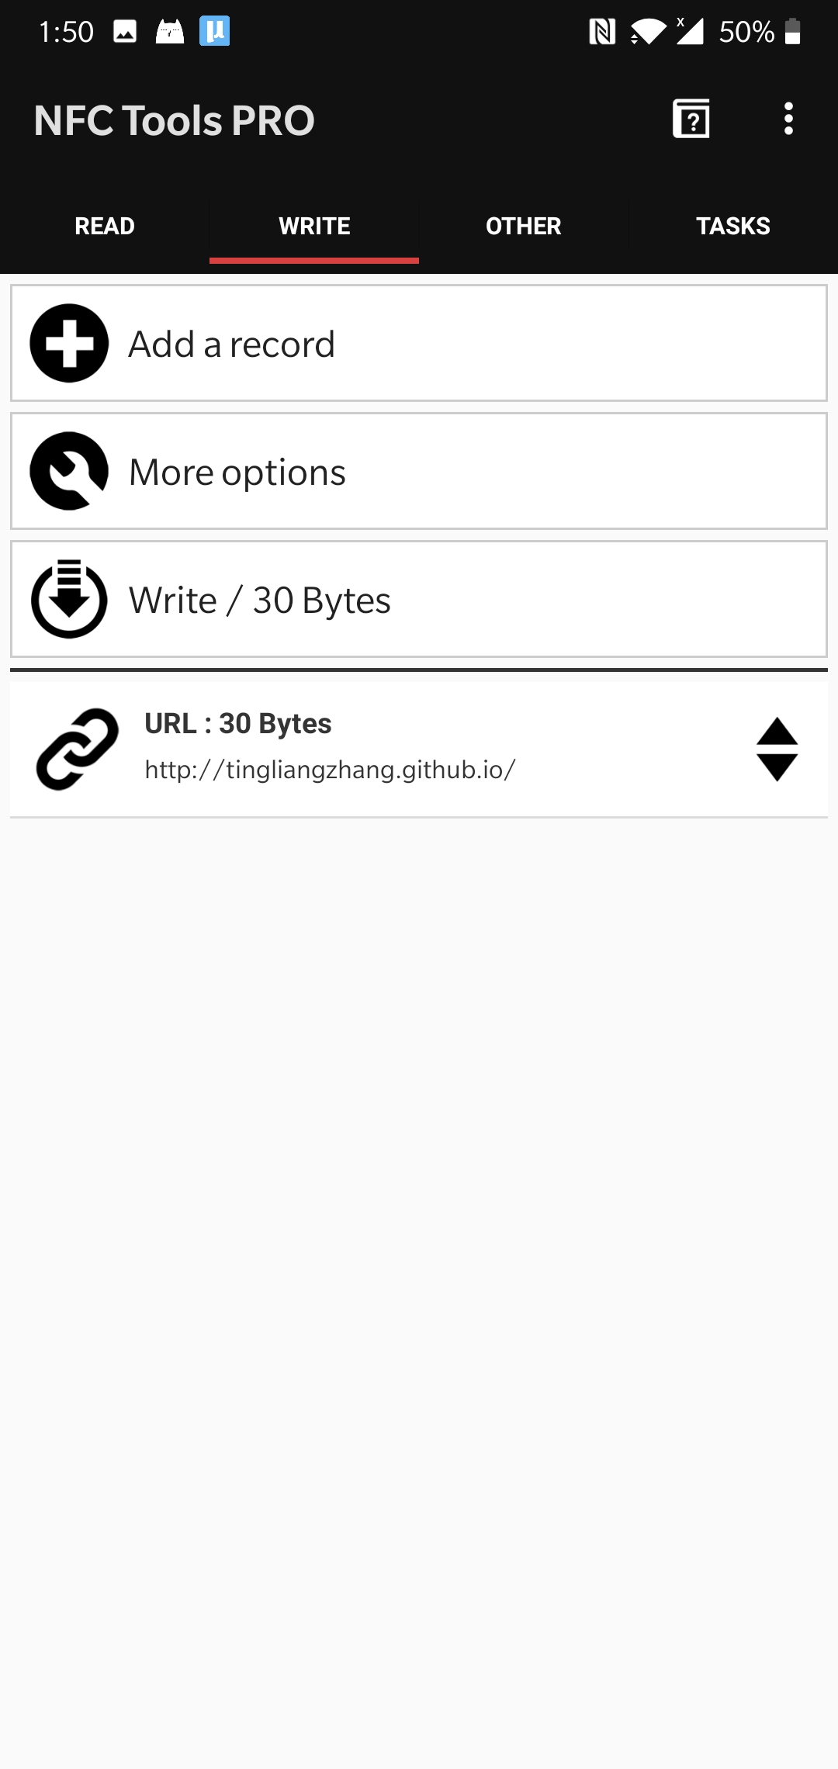
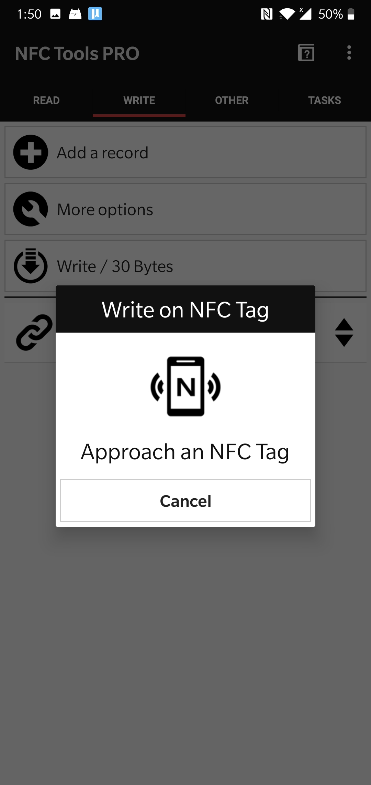
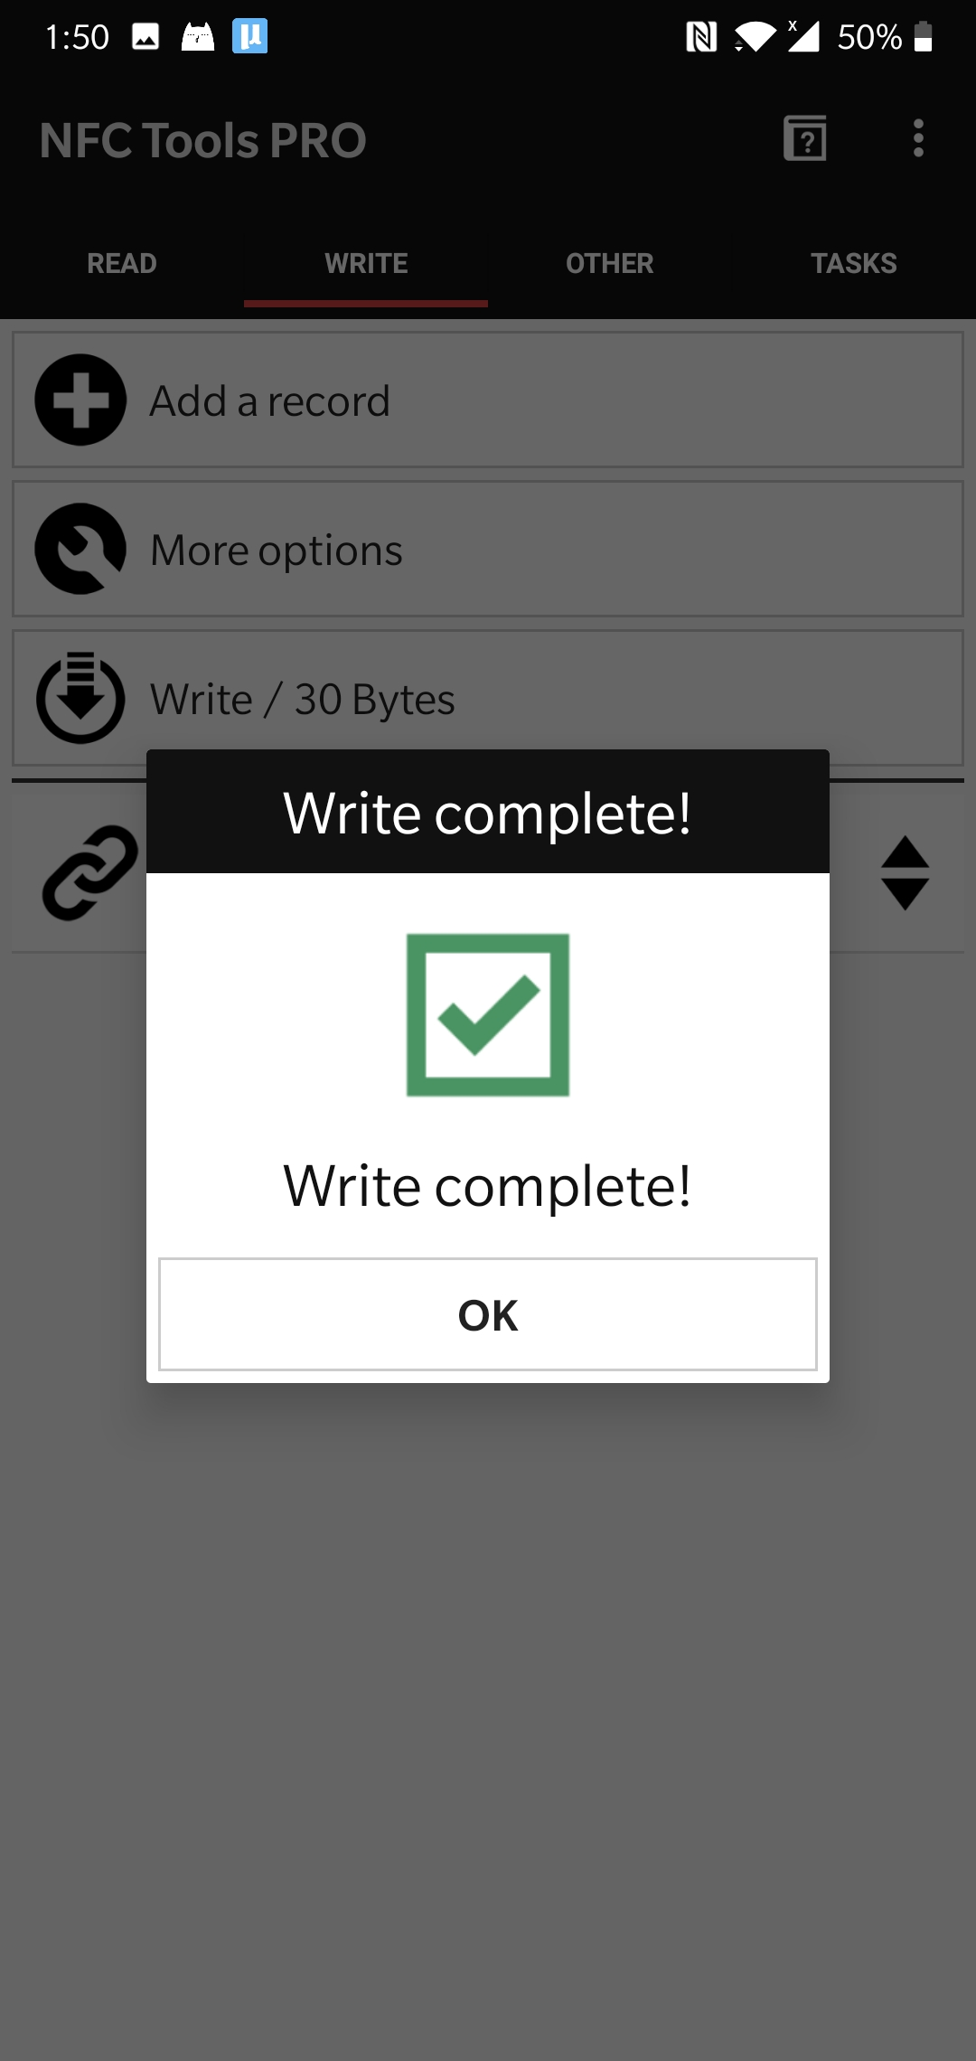

Slide 54
绿板子上的效果

Slide 55
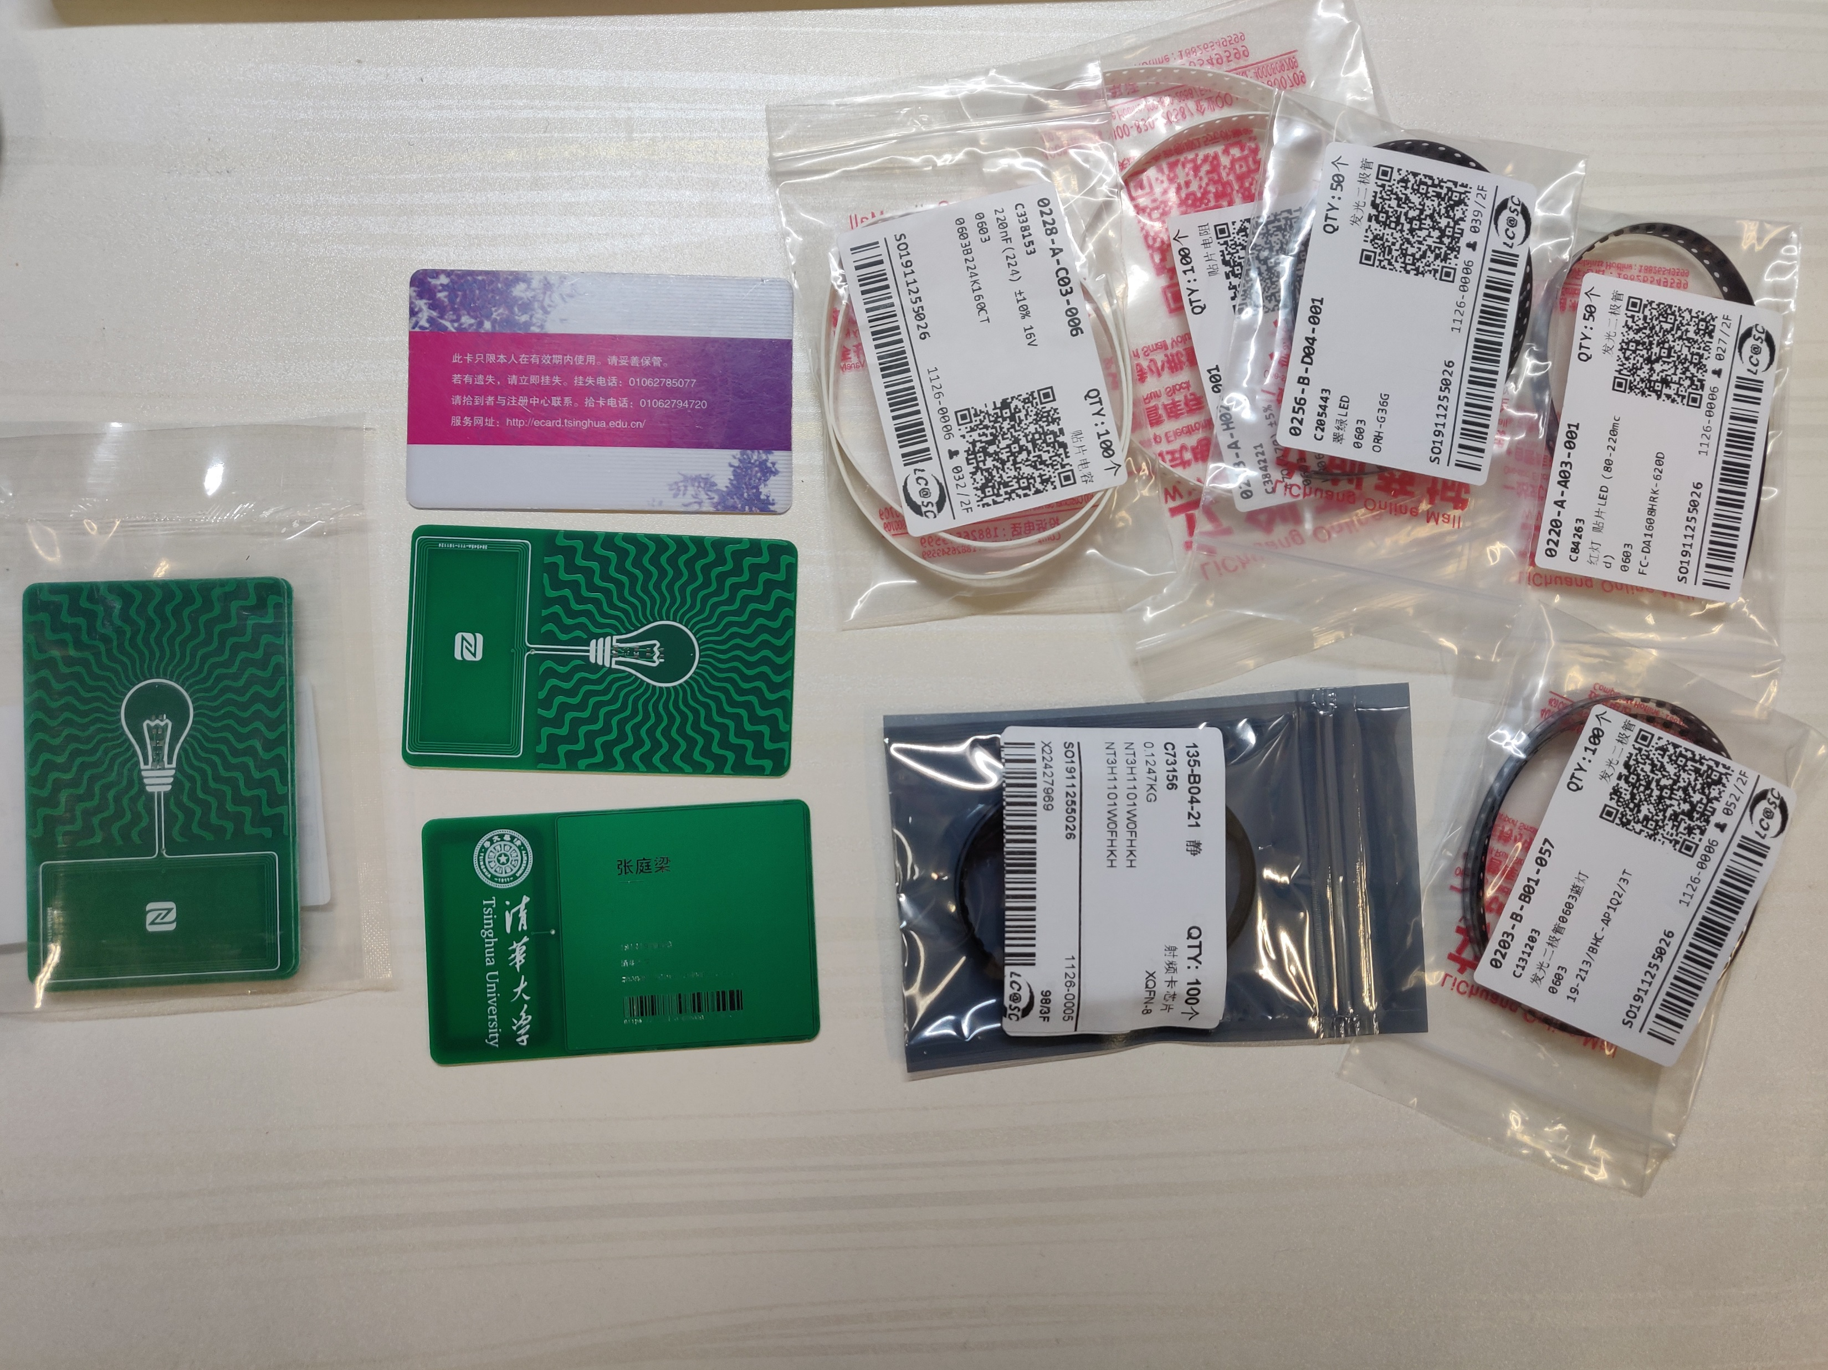

Slide 56
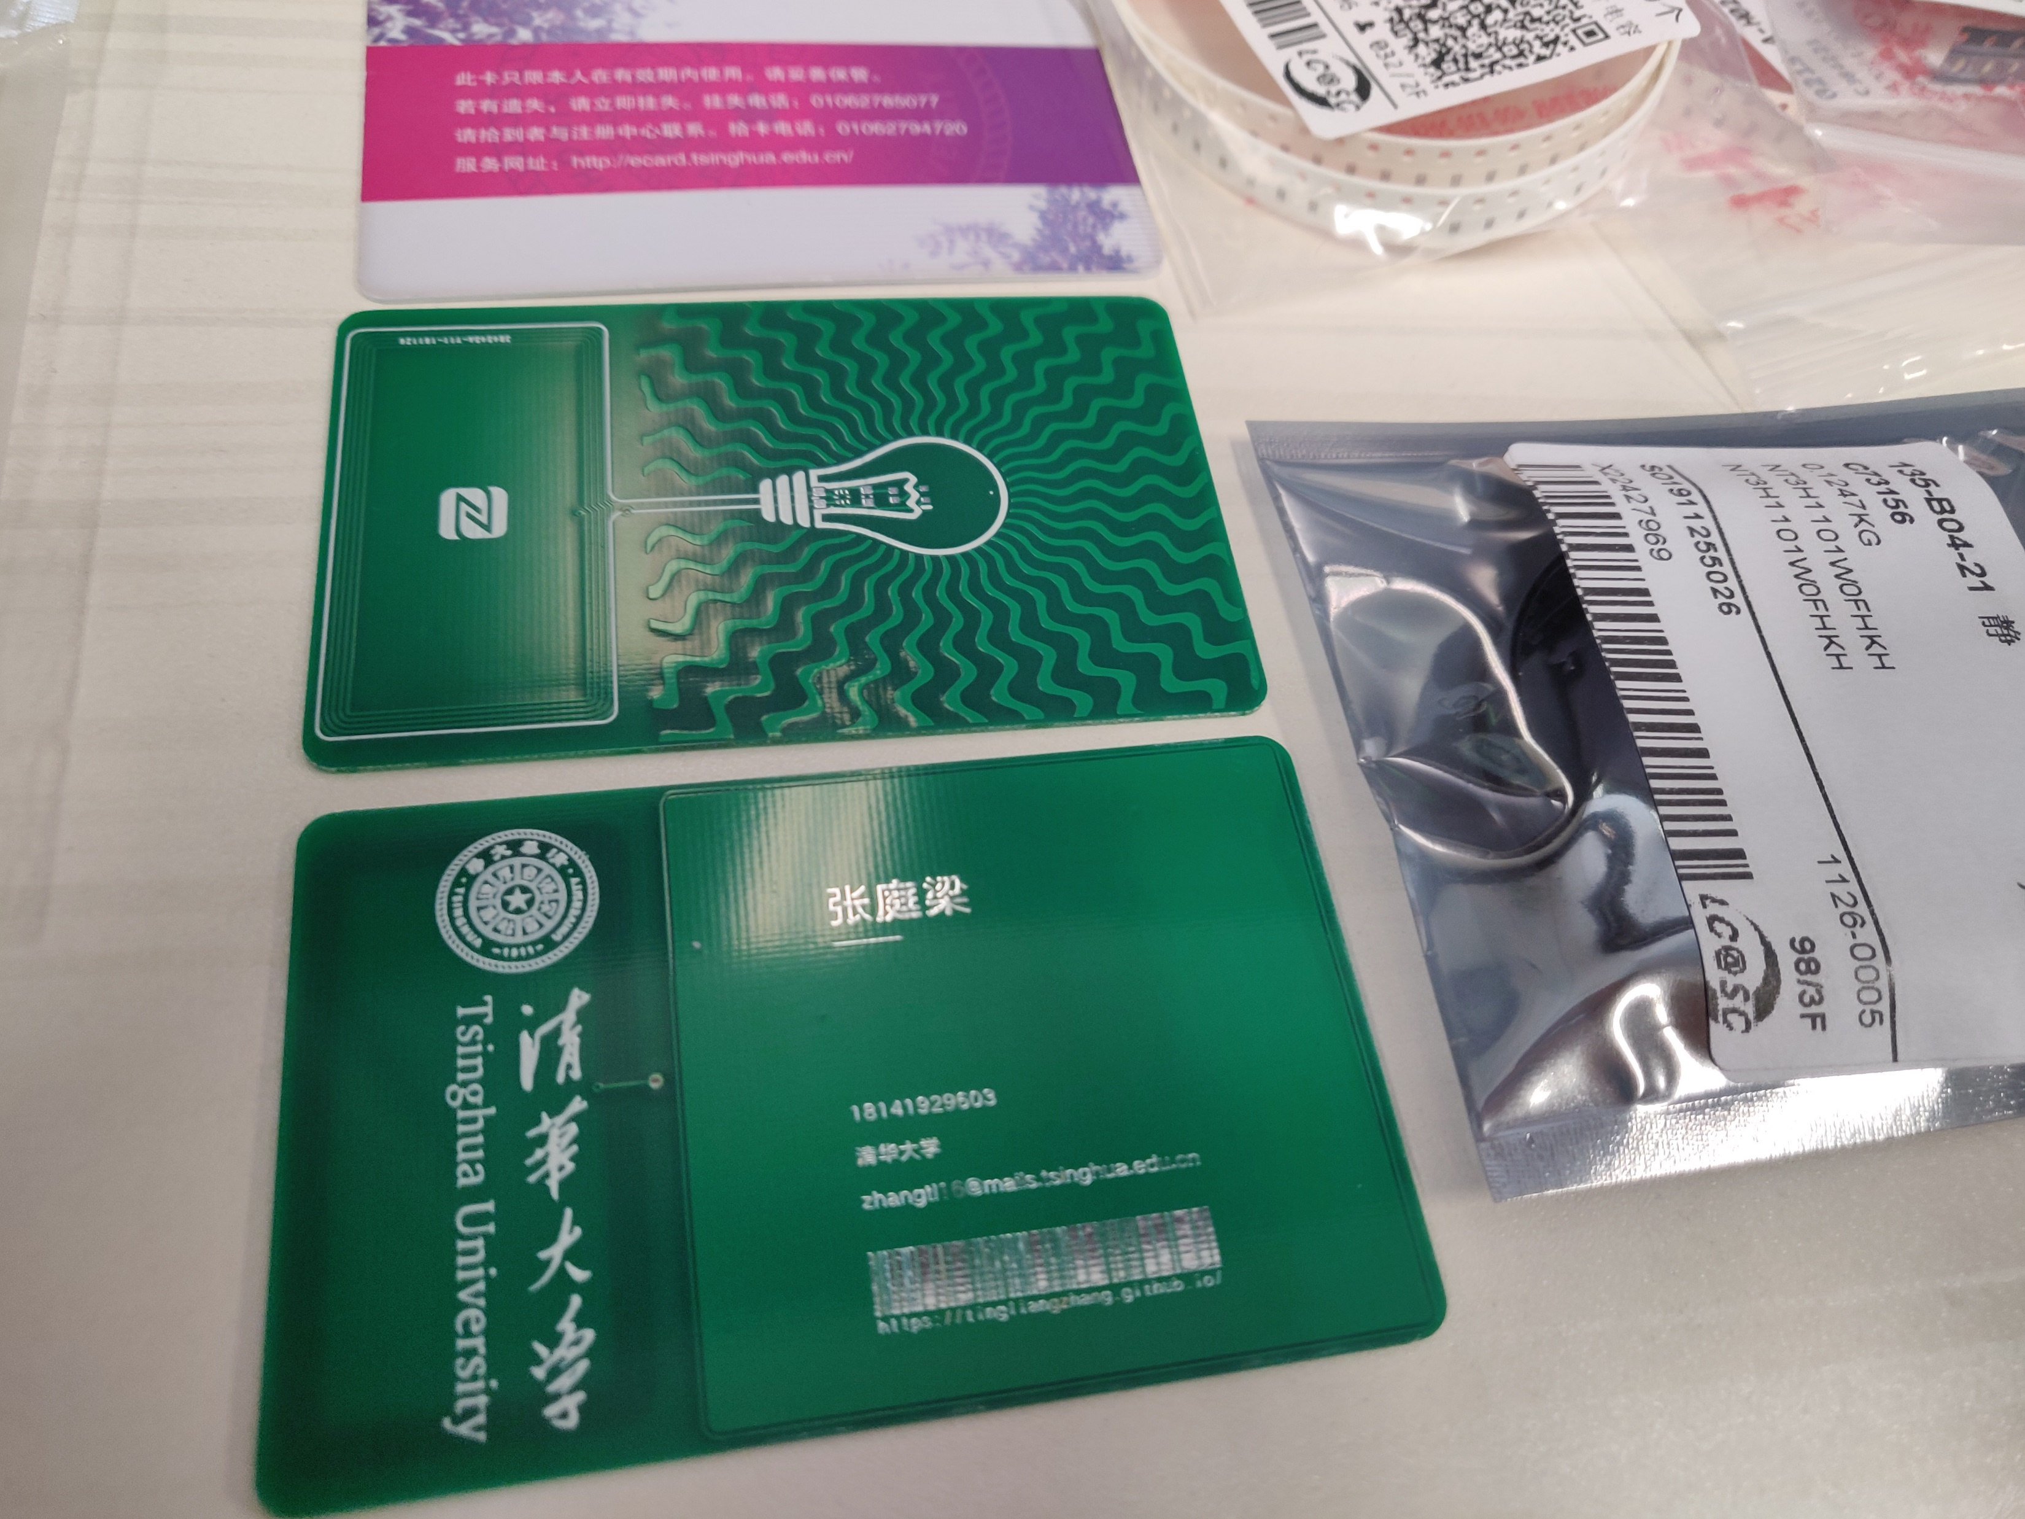

Slide 57
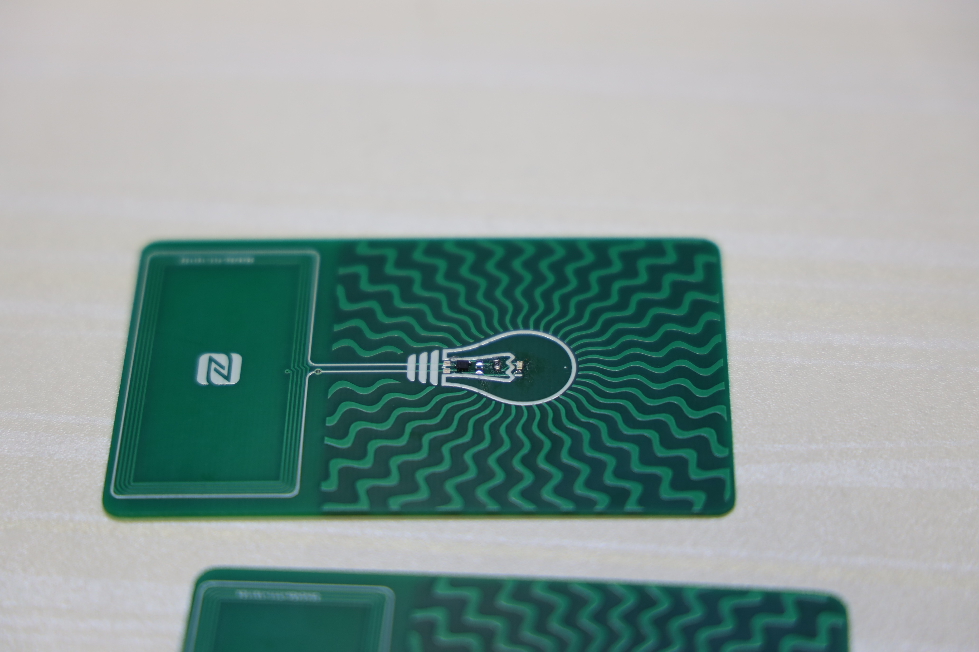

Slide 58
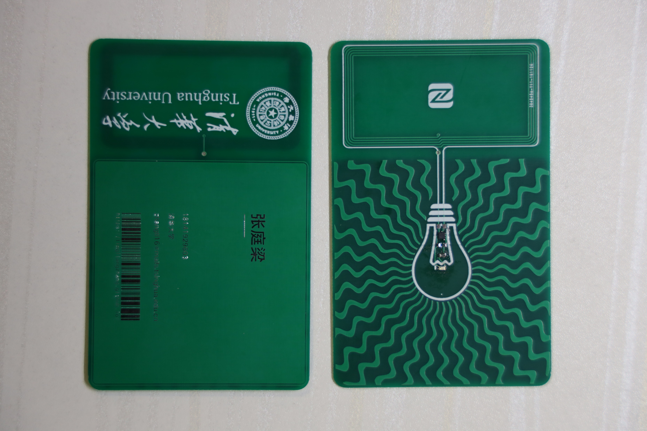

Slide 59
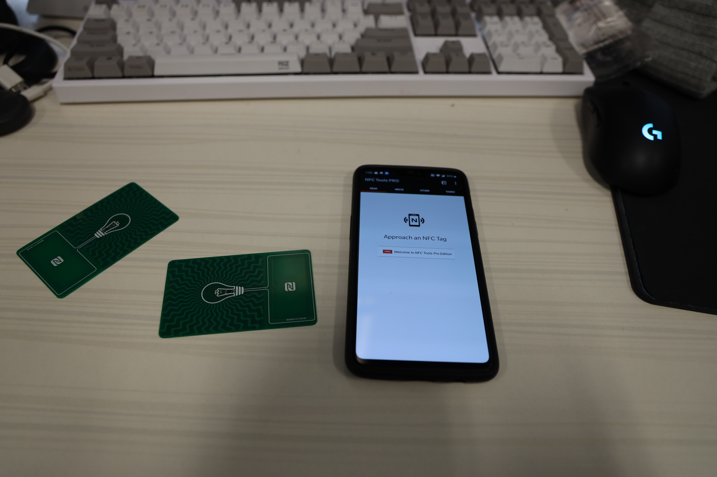

Slide 60
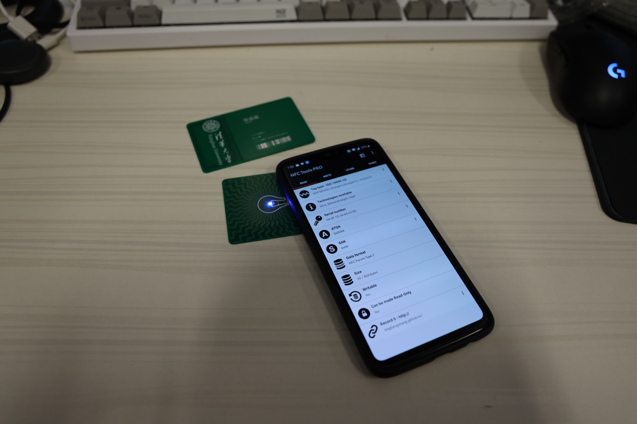

Slide 61
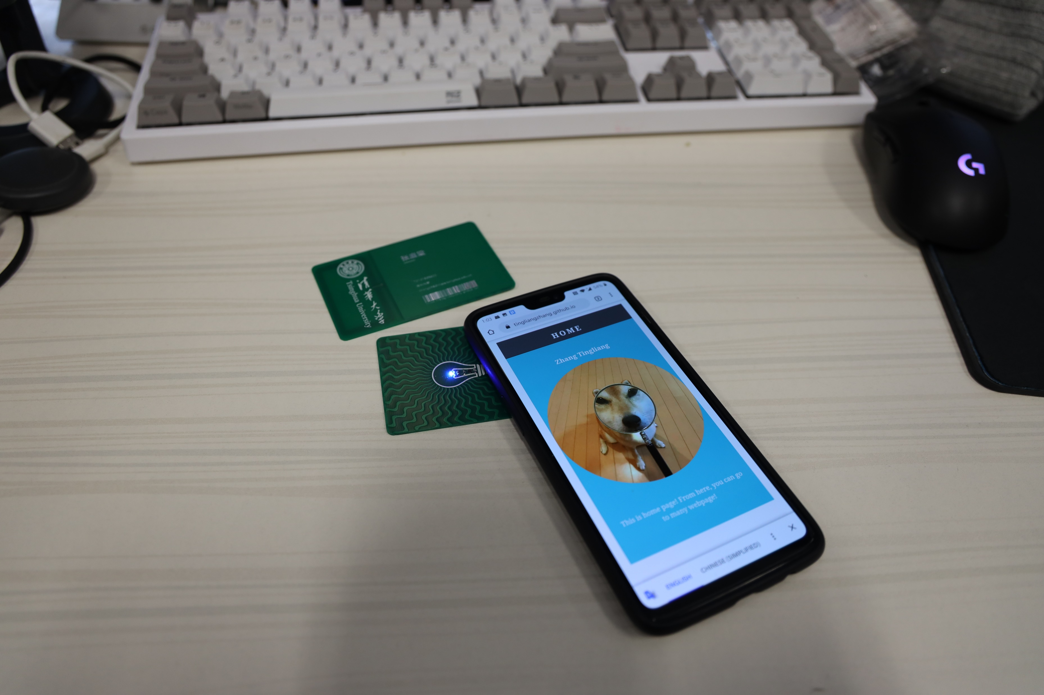

Slide 62
Tips
U? R? J?编号 Tools-Annotation-Annotate Schematics Quietly
Shift+Space键切换走线方式

